Slide 2
Requirements gathering
Design
Implementation
Testing
Deployment
Maintenance

Slide 3
Requirements Analysis
Acceptance Testing
System Design
System Testing
Integration Testing
Architecture Design
Module Design
Unit Testing
Coding

Slide 4
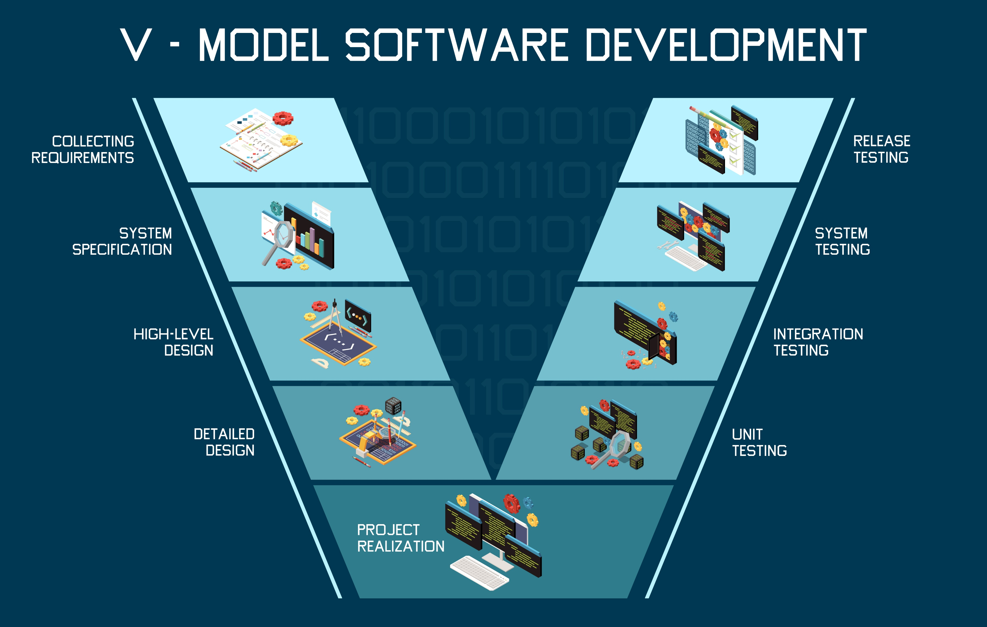
Notes:
(Designed by Freepik)

Slide 5
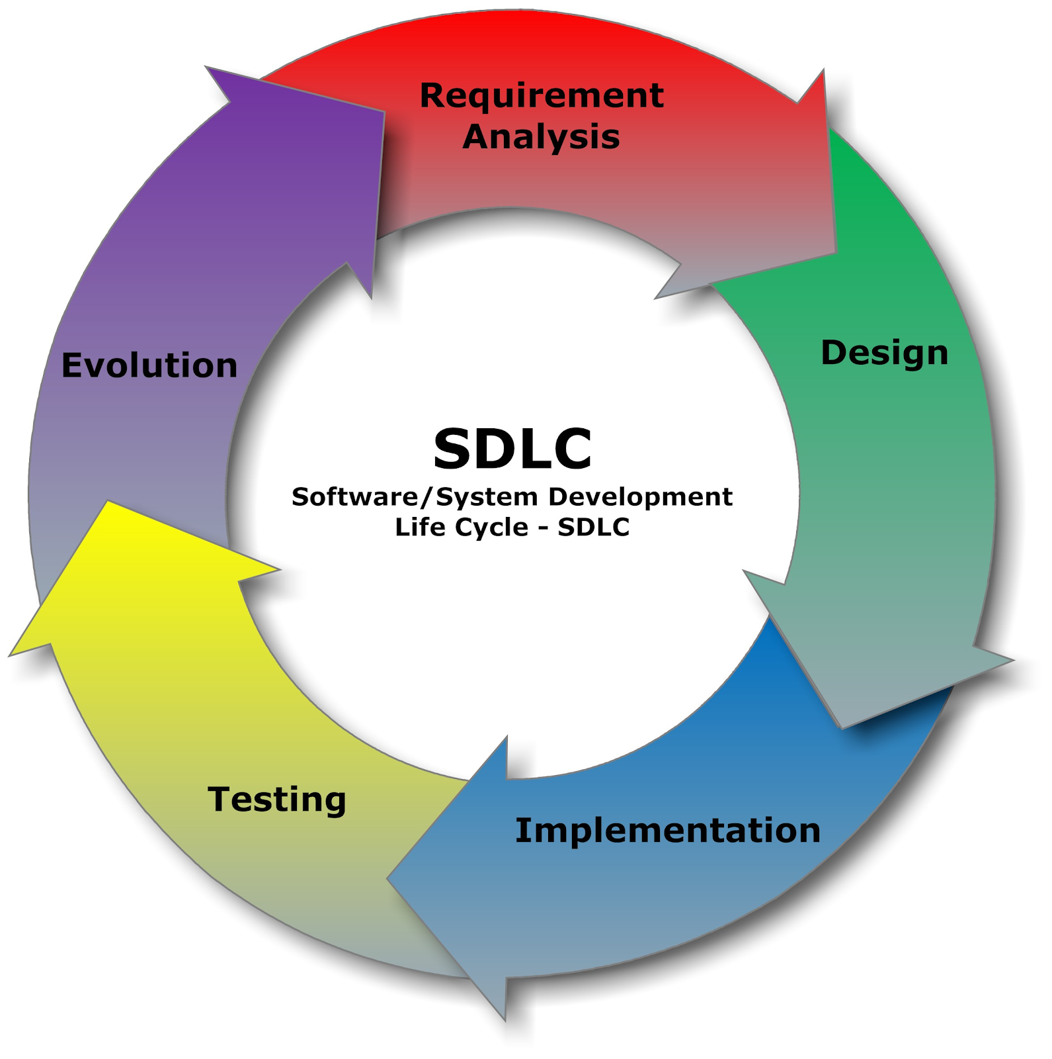
Notes:
(Image from The Carpentries Intermediate Research Software Development)

Slide 6
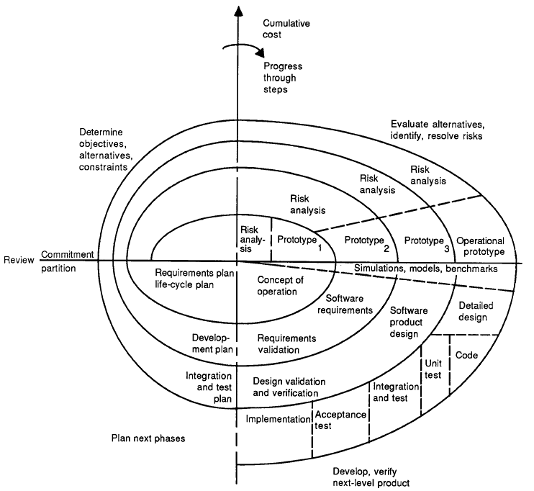
Notes:
(The Spiral Model Diagram from Boehm, 1987)

Slide 7
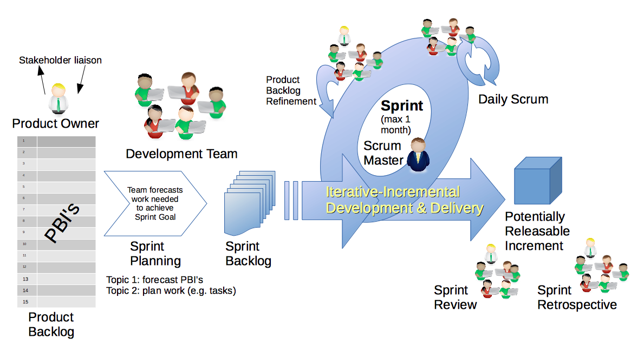

Slide 9
Sprint

Slide 10
Daily SCRUM
SCRUM
Your text
This slide is an editable slide with all your needs.
Your text
Your text
This slide is an editable slide with all your needs.
This slide is an editable slide with all your needs.

